Slide 1


EMPLOYEE DATA ANALYSIS
Presented by : shalini sharma

Slide 2
Objective
The objective of this project was to gain actionable insights into various aspects of employee demographics, engagement, training, and development within the organization. Leveraging Power BI Desktop's analytical capabilities, the analysis aimed to identify trends, patterns, and areas for improvement to inform strategic decision-making.

Slide 3
Key Insights Summary
Employee Demographics: The organization comprises 3000 employees, with an average of 10 years of experience. Gender distribution shows 32% male, 34% female, and 34% other. The average desired salary is $65,000.
Employee Engagement: The average engagement score is 2.94, indicating room for improvement. However, the average satisfaction score is at a moderate level of 3.
Employee Training and Development: The organization invests an average of $559 per employee in training. A variety of training programs are offered, with distribution visualized through stacked column bar charts.
Employee Status: Employees are distributed across various stages, including interviewing, rejected, in reviews, offered, and applied.

Slide 4
Employee Education: Educational level distribution includes Bachelor's degree, High school, Master's degree, and PhD.
Geographic Distribution: A map visualization highlights the geographic locations of employees.
Gender and Ethnicity: Gender distribution is depicted through a pie chart, while a slicer allows for the selection of ethnicity.
Job Title Filter: A slicer facilitates filtering based on job title, providing further insights into employee demographics and engagement across different roles.

Slide 5
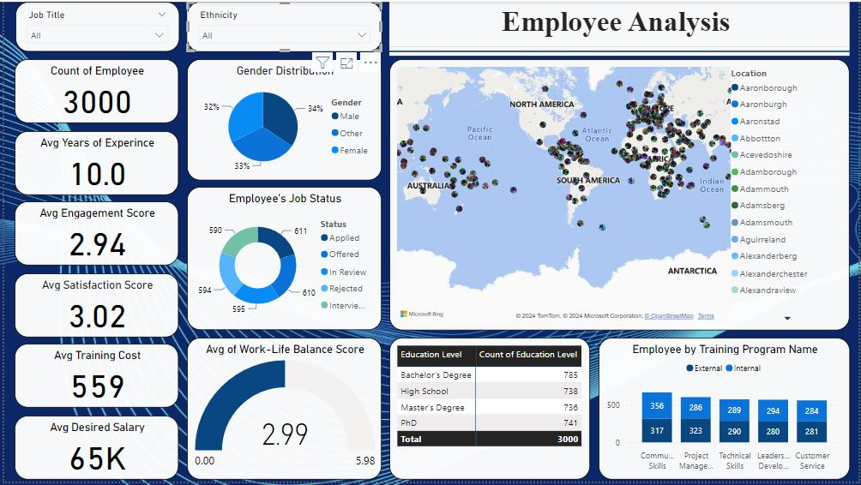
DASHBOARD

Slide 6
These insights serve as valuable inputs for strategic decision-making processes, enabling the organization to enhance employee engagement, optimize training and development initiatives, and foster a supportive work environment

Slide 7
THANK YOU
https://www.linkedin.com/in/shalini-sharma-02628525b/ -

